Slide 1

ATLAS Machine Learning Team SP24: Project Showcase
Sangjun Ko

Slide 2
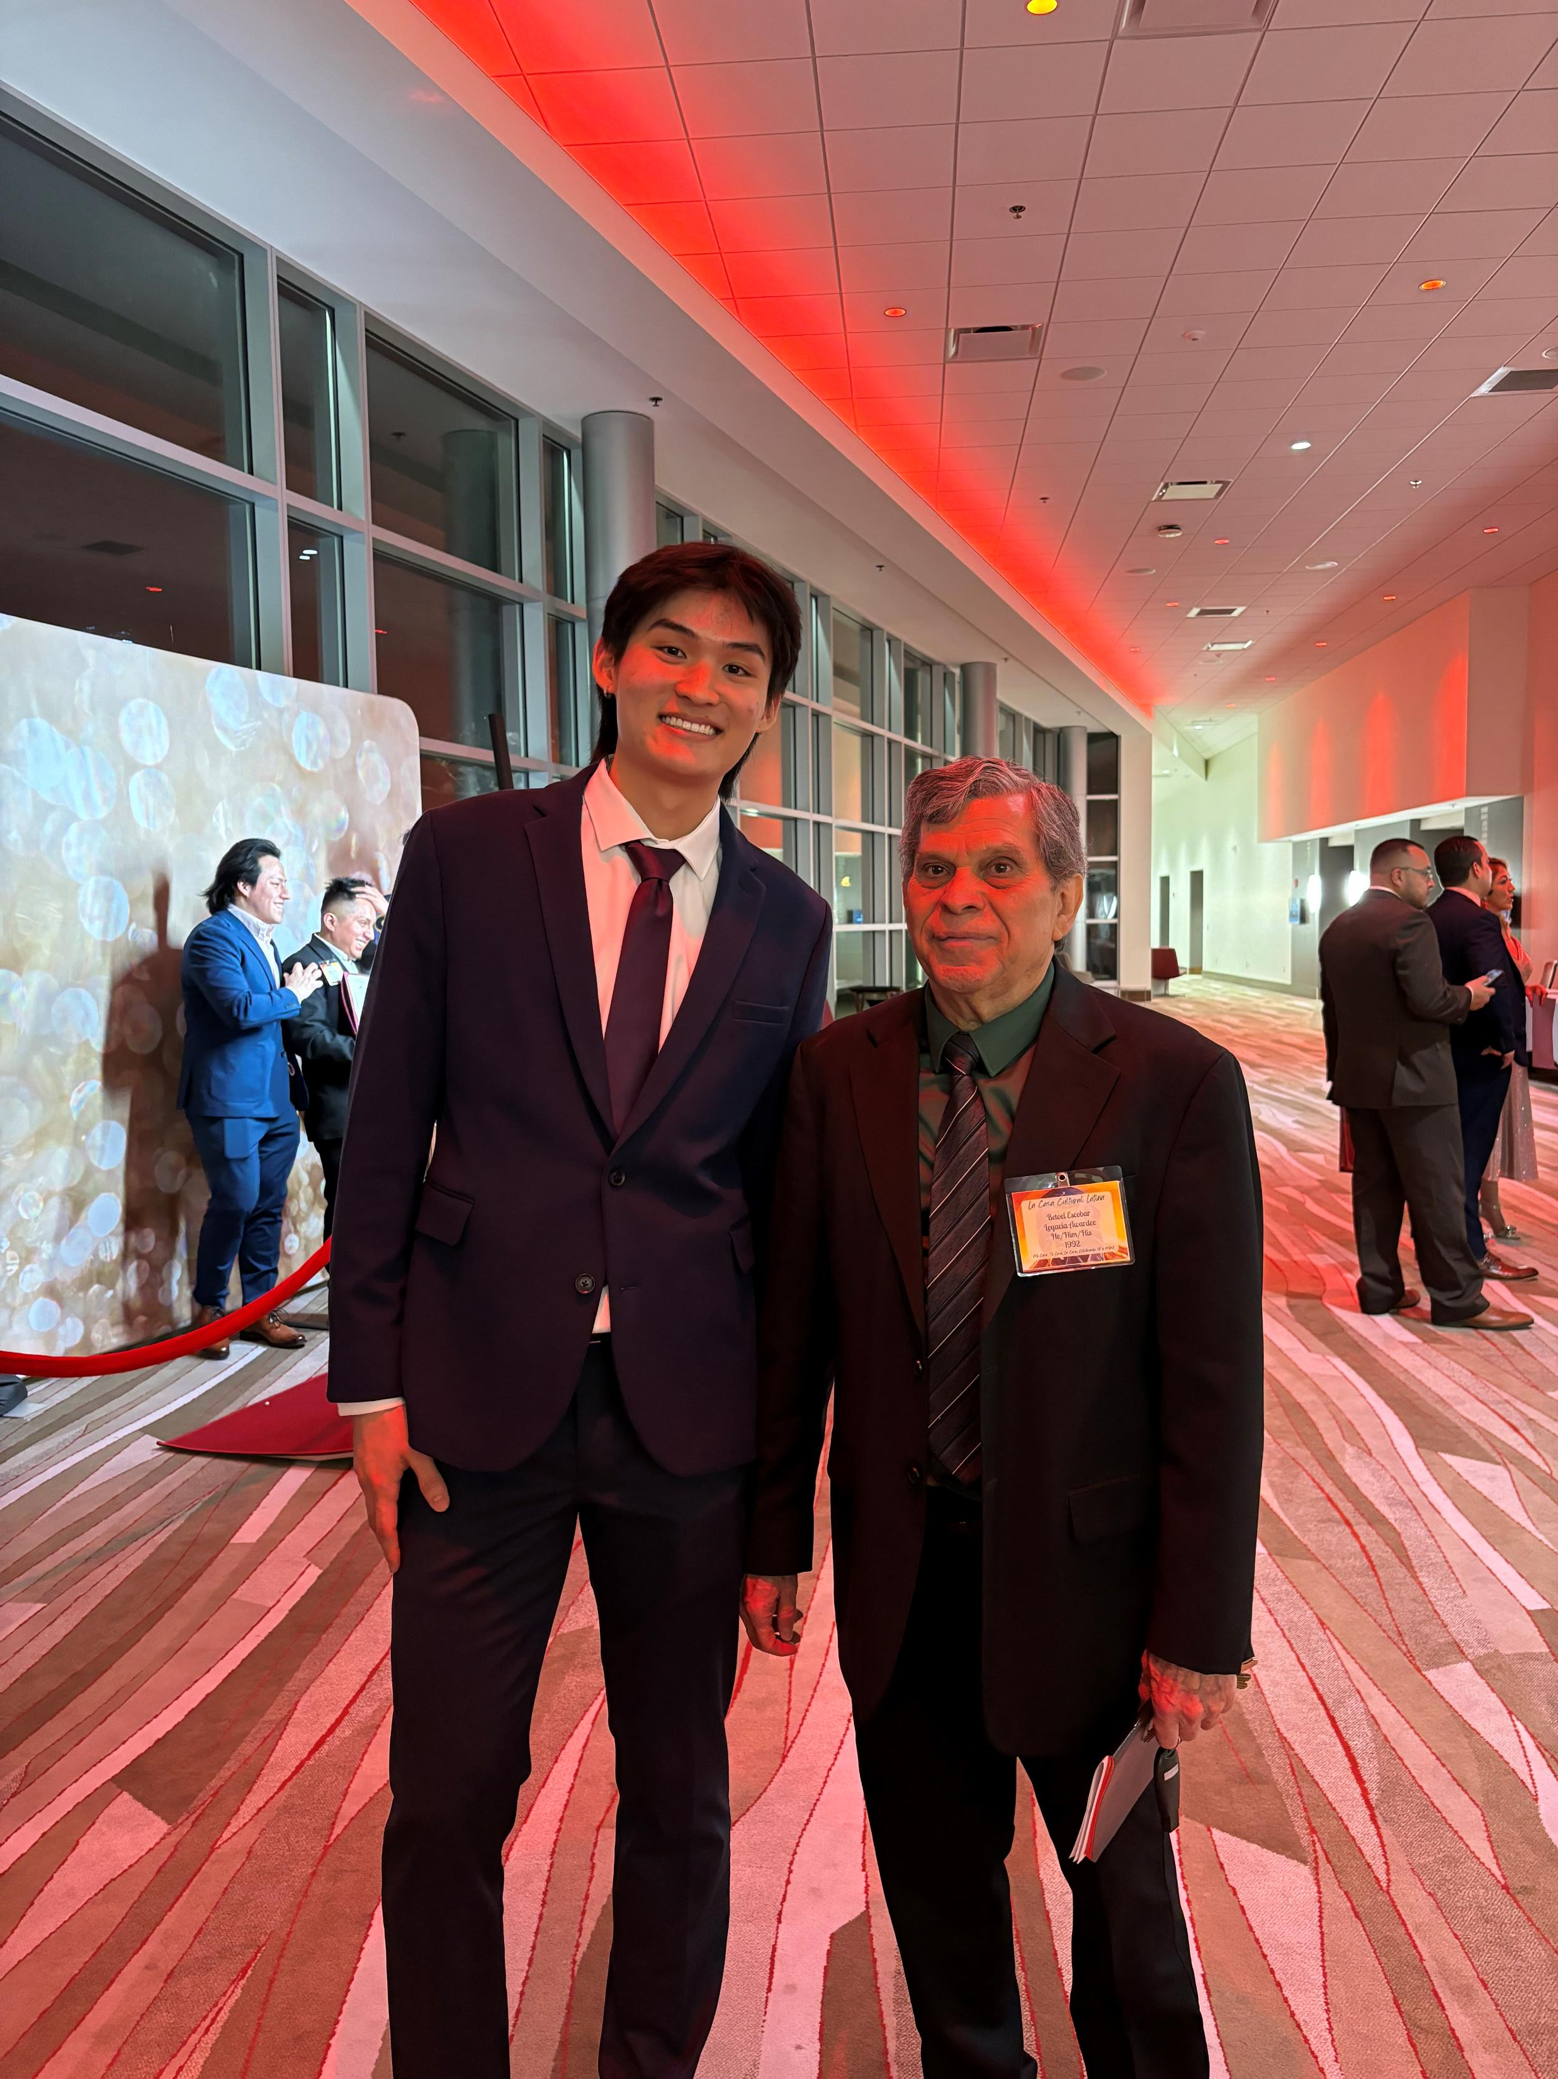
About me: Sangjun Ko
Junior
Statistics Major + Math Minor
ATLAS ML Team: Data Predictor Intern
Interests: Analytics/Consulting

Slide 3
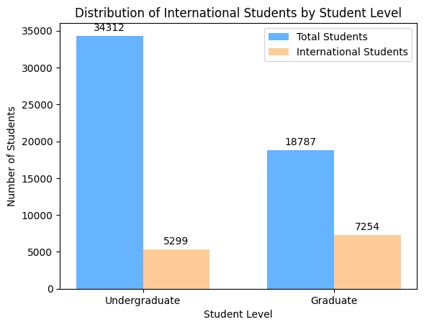
International Student in UIUC
Undergrad: 13%
Grad: ~38%
Popular Colleges:
Undergrad:
Liberal Arts & Sciences
Grainger Engineering
Gies College of Business
Division of General Studies
Fine & Applied Arts
Grad:
Grainger Engineering
Gies College of Business
Fine & Applied Arts
Agr, Consumer, & Environmental Sciences
School of Information Sciences

Slide 4

Purpose
Be able to correctly forecast international students in UIUC
Use the model to see if there can be any improvements made in order to keep a growing population of international students or to maintain the population.

Slide 5

Deterministic Linear Regression
Linear Regression:
Chosen for modeling relationships between features and target variable.
Assumes a linear relationship, offers interpretable coefficients.
Advantages: Simple to implement, computationally efficient.
Deterministic Process:
Opposite of randomness, yields consistent results.
Models relationship between time index and studied variable.
Provides structured understanding and predictable behavior.
Forms basis for forecasting and informed decision-making using historical data.

Slide 6

Project Demo

Slide 7
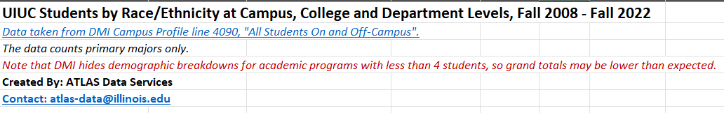
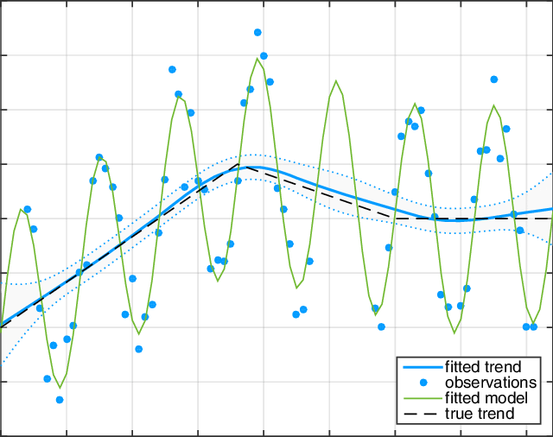
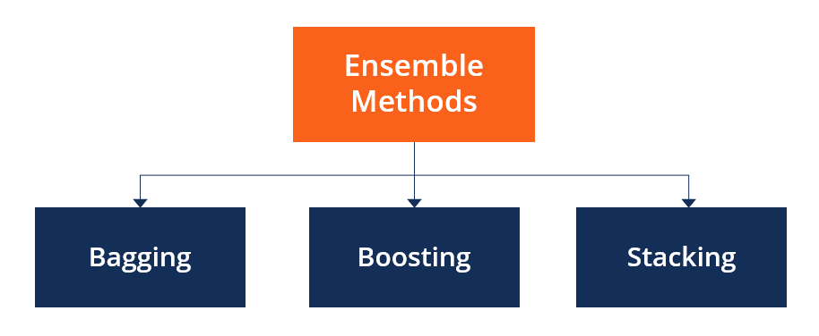

Challenges and Future Research Directions
Challenges
Future Research Directions
Data Extraction
Website Interface Development
Dynamic Modeling
Ensemble Methods

Slide 8
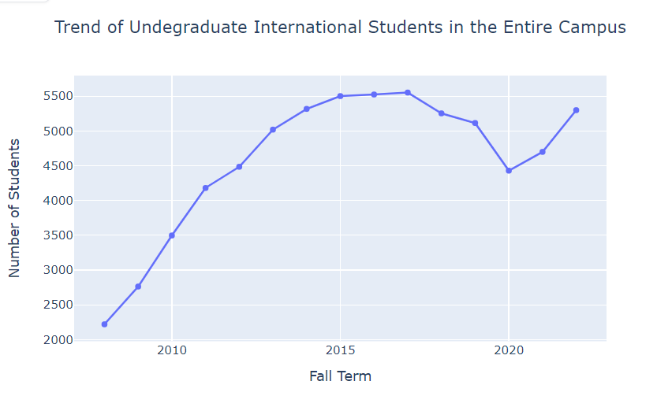
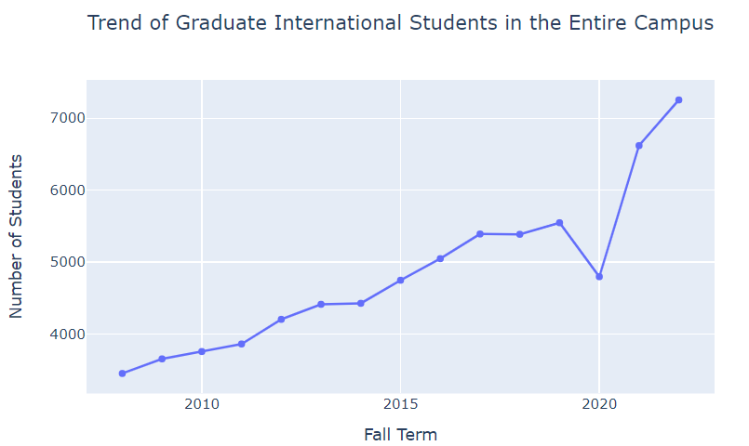
Takeaways and Call to Action
Insights into Enrollment Trends
Strategic Planning
Competitive Advantage
Policy Implications
Dashboard Deployment
Student Support Services

Slide 9

Thank you
Sangjun Ko
sangjun2@illinois.edu
217-369-0668

